Slide 1
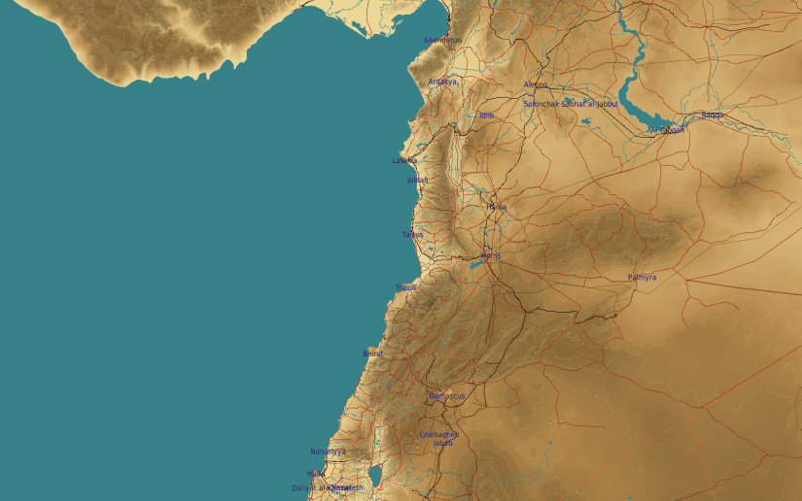
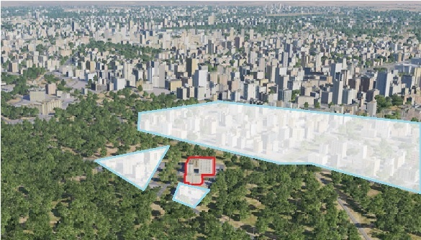
SYTGT094 Syrian Intelligence Internet Agency
N
94
DESCRIPTION OF THE DESIRED POINTS OF IMPACT WITH WPN TYPE:
SYTGT094A – Internet Agency Centre
DPI 1 N33 30.849 E036 16.059/2276ft/(2000 Ibs bomb)
SYTGT094B – Analyst Centre
DPI 2 N33 30.840 E036 16.080/2273ft/(1000 Ibs bomb)
SYTGT094C – Server Halls
DPI 3 N33 30.856 E036 16.073/2273ft/(1000 Ibs bomb)
SYTGT094D – Power
DPI 4 N33 30.874 E036 16.049/2276ft/(1000 Ibs bomb)
Collateral Damage Concerns
Intelligence Internet Agency
4
5
6
Residential areas N, E and S of the facility within 50m.
7
8

Slide 2
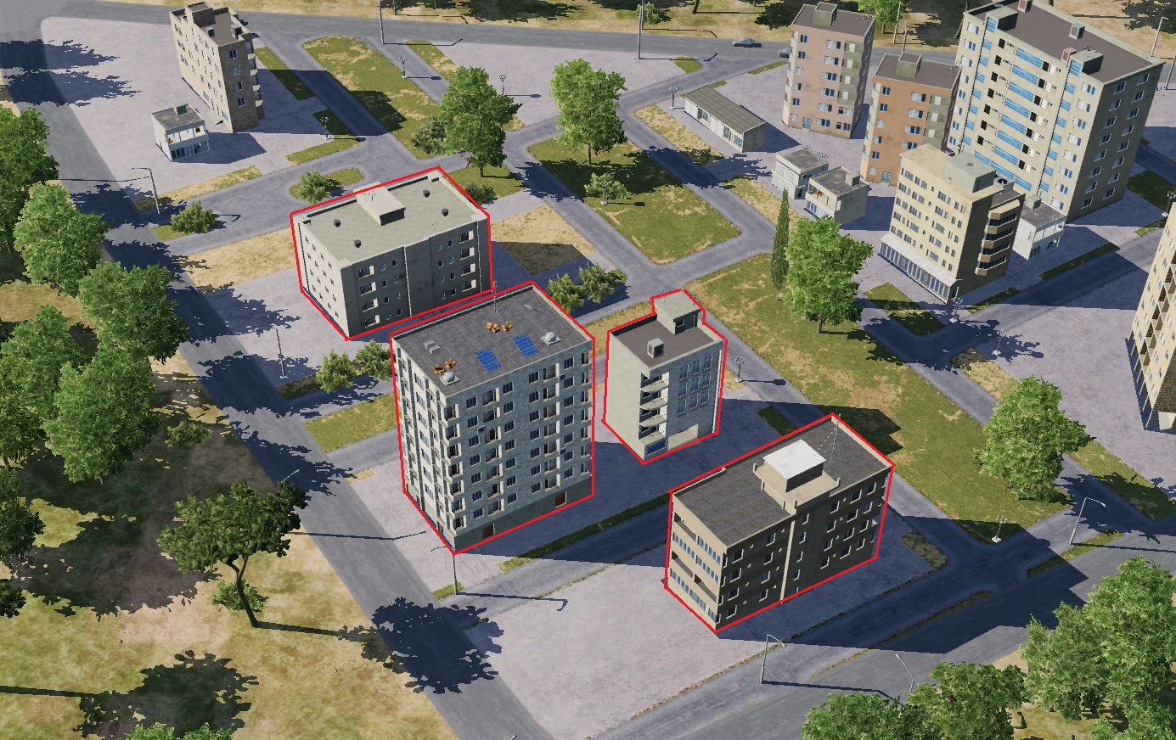
SYTGT094 Syrian Intelligence Internet Agency DPIs
SYTGT094A – 8 storey buildings made of concrete slab supported by reinforced concrete base and pillars, flat poured roof.
SYTGT094B/C/D – 5 storey building, walls made of slabs, poured roof supported by metal frame and reinforced concrete pillars.
N
SYTGT094D
4
SYTGT094B
1
1
2
SYTGT094A
3
SYTGT094C

